Slide 1

Alpaca OVERVIEW
2012

Slide 2
AGENDA
AlpacaE SPEED OF IDEAS
Eastern Europe South Presence
Capabilities in Eastern Europe South Region
Conclusions

Slide 3

Alpaca
AT THE SPEED OF IDEAS
Alpaca at a glance

Slide 4
VISION
TO REALIZE THE POTENTIAL OF A CONNECTED WORLD.
OUR MISSION
TO DELIVER THE INNOVATION OUR CUSTOMERS NEED TO STAY AHEAD,
TO EVOLVE, TO BECOME MORE EFFICIENT, AND TO MOVE AT THE SPEED OF IDEAS.
CORPORATE SIGNATURE
AT THE SPEED OF IDEAS.

Slide 5
Alpaca
REALIZING THE POTENTIAL OF A CONNECTED WORLD
“
Broadband everywhere is speeding up life and business. It takes no time to go from having a new idea, to touching peoples lives. We must innovate – and help our customers innovate – at
“
the speed of ideas.
Bryce Verstappen
Chief Executive Officer
FAST FACTS | Headquarters: Paris, France Annual Revenues: approx. €16 billion Employees: 77,000 + | R&D Budget: €2.5 billion Active Patents Held: 27,900 Patents Awarded in 2010: 2,400
 | 130 countries | Nobel Prizes Won: 7

Slide 6
BELTHAZAR LABS
INNOVATING AT THE SPEED OF IDEAS
GLOBAL REACH
A HERITAGE OF INNOVATION
PRESENCE IN 8 COUNTRIES
LIFE-CHANGING TECHNOLOGIES
DSL ▪ Digital signal processing
PON ▪ CCD
WiMAX ▪ Communications satellites
WDM ▪ The laser
The transistor ▪ Cellular telephony
Belgium
China
France
Germany
India
Ireland
South Korea
United States
MARKET IMPACT
DEFINING THE FOREFRONT OF THE INDUSTRY
27,900 active patents
Collaboration with >250 universities worldwide
Multiple Open Innovation Initiatives
2010 BREAKTHROUGHS
waveTech
100G optical transmission
DSL Phantom Mode

Slide 7























GLOBAL REACH
% of 2010 revenues
N. America: ~36% | Europe: ~32% | Asia Pacific: ~18% | Rest of world: ~14%
Russia Romania
Ireland UK
Belgium
France Germany
Poland Slovakia
Canada
Turkey Israel
South Korea China
USA
Netherlands Italy
Spain
India
Taiwan
Singapore
Brazil
Australia
Worldwide Presence
more than 130 countries
Executive Business Centers Research Centers
Product & Solution Development Centers
IP Transformation Centers
Employee Nationalit ies
more than 100

Slide 8
















CUSTOMERS WE SERVE
SERVICE PROVIDERS
STRATEGIC INDUSTRIES
ENTERPRISES
A leader in mobile, fixed, IP and optics technologies, and a pioneer in applications and services, we offer complete solutions that help service providers and their customers realize the potential of a connected world.
We help our enterprise and government customers worldwide interconnect their networks, people, processes and knowledge to make money and save money.
We provide end-to-end turnkey communications integration that improve quality of life through better energy management, efficient transportation and improved government services.

Slide 9
Eastern Europe South Presence
Alpaca - Regional

Slide 10

Do you know what set of professional activities for the Communications Infrastructures we
offer?

Slide 11
Alpaca Eastern Europe South has endless capabilities
…Consult and Design, Integrate and Deploy, Operate and Maintain for complex end-to-end turn key projects

Slide 12
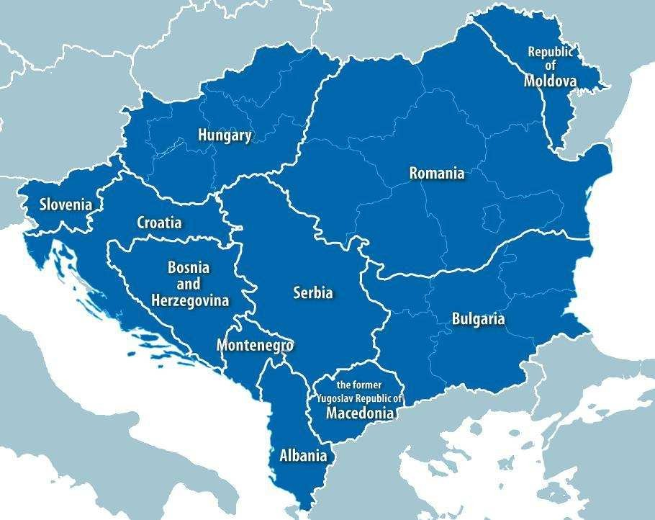
Alpaca in Eastern Europe South
Alpaca Romania
is a hub of Eastern Europe
South Region: coordinating 11 countries & 1 Region
▪ having over 4500 employees in the region from which dedicated personnel for projects (e.g.2700 people for Vivacom outsourcing project in Bulgaria; over 1600 employees in Romania / Timisoara involved in R&D, Services and support functions for global projects)
OPERATIONAL MODEL
Indirect Sales:
Based on Representative Offices and Local Partnerships that function in EES8
– Moldova, Macedonia, Albania, Montenegro, Bosnia and Herzegovina, Croatia, Slovenia, Kosovo
OPERATIONAL MODEL
Direct Sales:
Romania – 1600 employees Business & Sales Operations, Communications, Finance, Global
Accounts, Human Resources, QA&CC, Pre- Sales, Regional Sales, Solutions & Marketing
Hosted R&D Activities - Applications, Wireless, Optics, Services
Bulgaria – over 2500 employees Services MOD, Procurement, Strategic Industries, Region functions (Finance, HR,
Sales, QACC)
Serbia – over 26 employees
Procurement, region functions (QACC,
Sales, PreSales, Finance)
Hungary – over 35 employees
Sales, Presales, Finance, Services

Slide 13
Alpaca Romania – Capabilities
OSS/BSS Competence Center
➢ Activities performed:
➢ Software development, integration/customization
➢ Functional and acceptance tests
➢ Installation and support on customer site
➢ Maintenance and support
➢ Project documentation (specification,test documents, user guide…)
➢ Technical project management
➢ Existing competencies in following applications:
➢ Billing
➢ Charging Gateway
➢ Fault management/Service Troubleshooting
➢ Provisioning (based on Cramer,Axiom,Comptel)
➢ Performance Management
➢ ICC/OSP
➢ Call Center (Genesys)
Alpaca University
one of 21 global training centers
global qualification and learning solutions for clients, partners and employees
partnerships with Technical Universities in Timisoara, Bucharest, Cluj-Napoca, Arad
course development for university curricula together with the academics
A central resource for HR support, the EMEA HR Service
Center provides high-quality, timely and consistent HR service to employees across Europe, Middle East and Africa (EMEA).
Up to 100 professionals
Capabilities:
- General HR inquiries.
- Employee and Manager Self-Service
- HR Policies and Forms.
- HR Process and Program questions.
- Questions on HR Tools.
- Any other HR related inquiry.
Focus on Network and System Integration, Global Network Operations Centre, Mobile Multimedia and
Project Management Support & Tools
Over 500 engineeres
- Network and System Integration Division deals with specification, 3rd party customization, configuration, testing, on site installation, customer support, integration
- Global Network Operations Centre (GNOC) are mobile (Tier 1 for clients in Switzerland, Belgium and Austria) and fixed (Tier 1, 2 and 3 for Winston BT Project) - Vivacom Bulgaria, Winston Project, Orange Switzerland, Sunrise Switzerland, Base Belgium, Orange Austria
- Mobile Multimedia Division deals with Mobile Unicast and Mobile Broadcast, Mobile Advertising, Rich Media Client
- Project Management Support & Tools (PMST) Team works on some tens of important projects covering EMEA and APAC regions
Optics R&D development center contributing to the development of Optics product portfolio.
Over 100 engineers
➢ ODC is involved in the development of terrestrial and submarine WDM (high capacity and long distance transport solution over optical fiber) and CC products.
➢ ODC participates to the development of Optics solutions used for complex transport networks.
Capabilities:
- System engineering
- Software development
- Testing (software integration, Pre-Integration and validation)
- Simulators and testing tools for development teams
Wireless R&D development center contributing to the
development of LTE, WCDMA, GSM, CDMA and TD- SCDMA product portfolio.
Over 530 engineers Capabilities:
- System definition
- O&M, MFS, transcoder development
- Methods & Customer documentation
- System Validation Tests
- First Off and Acceptance
- Network engineering (2G, 3G and 4G/LTE)
- Product support and Technical Support level 2 and 2+
- PreSales tools development
- Network Design
- Project Management and Technical project management
- Installation & Commissioning
Applications R&D development center contributing to the software development for media servers, digital media
applications, video streaming server, content management applications and e2e test platforms for applications.
Over 100 engineers
Endless possibilities

Slide 14
Capabilities in Eastern Europe South Region
Alpaca - Regional

Slide 15
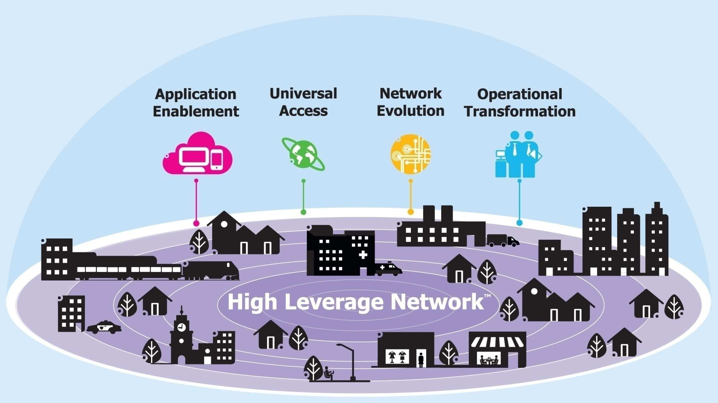

HIGH LEVERAGE NETWORKTM (HLN)

Slide 16








HIGH LEVERAGE NETWORK™
A PLATFORM FOR VALUE CREATION
UNIVERSAL ACCESS
APPLICATION ENABLEMENT
PROVIDE BROADBAND EVERYWHERE
Deliver wireless all around
Enable open access for all
Bridge the fixed and mobile worlds
CAPTIVATE YOUR CUSTOMERS
Pioneer new media, new content, new applications
Manage the real-time end customer experience
NETWORK EVOLUTION
OPERATIONAL TRANSFORMATION
LEVERAGE YOUR NETWORK
Address the data explosion
Deliver service innovation at speed
Transform and simplify
your network
TRANSFORM YOUR OPERATIONS
Optimize costs
Increase focus on superior QoE and growth drivers
Mitigate transformation complexity and risk

Slide 17
IDEAS FOR GROWTH
MARKET GROWTH PROGRAMS
WIRELESS ALL AROUND
Innovating and defining business models to support mobile data demand and new applications
CUSTOMER EXPERIENCE TRANSFORMATION
Creating and providing ways to attract and retain customers managing end user experience
APPLICATION AND CONTENT VALUE CHAIN
Creating new & profitable opportunities to use network capabilities and shape the new application and content value chain
CLOUD
Offering ways to use network capabilities and claim a vital role in the Cloud of the future
CRITICAL NATIONAL INFRASTRUCTURE
Providing ubiquitous broadband access, security and reliability for critical national and strategic industries infrastructure
INTERNET OF THINGS
Offering alternatives and reducing complexity (business models, ecosystem and standards) to achieve the potential of The Internet of Things

Slide 18





















References/proof of our expertise
Mobile Operators
Fixed Operators

Slide 19



THE DYNAMIC ENTERPRISE
ENABLE DYNAMIC CUSTOMER ENGAGEMENT
Interactive Voice Response & voice portals
eServices & social engagement
Intelligent workload distribution
Workforce optimization
Analytics & performance management
FOSTER COLLABORATION
Collaboration applications
Voice, web & video conferencing
Mobility
Desktop phones & end points
Communications platforms
PROVIDE APPLICATION FLUENT NETWORK
Service-aware networks
Converged networks
Data centers
Managed access services

Slide 20
STRATEGIC INDUSTRIES
Delivering critical national infrastructure and helping improve quality of life through better energy management, more efficient transportation and improved government services.
THE CUSTOMERS WE SERVE
WHAT WE DELIVER
AN ENGINE FOR GROWTH
TRANSPORTATION
Railways Highways Airports
ENERGY
Utilities Oil
Gas
PUBLIC SECTOR
Defense Public Safety eGovernment
End-to-end communications systems integration from initial design to complete operation of the network.
We integrate:
Alpaca network hardware and software
Third party products
Alpaca applications.
2010 ORDERS: €1.2 billion
GROWTH IN 2010: 12%
We leverage stimulus programs, government development funds and private public partnerships aimed at helping both developed and developing countries improve quality of life and drive economic development.

Slide 21





















References/proof of our expertise
Energy and Utilities
Transportation

Slide 22









References/proof of our expertise
Public sector
Health Optimum – Partnership Agreement with Orange Romania-SAP
Ministry of Defense (Romania)
Ministry of Defense (Bulgaria)

Slide 23
Conclusions

Slide 24

Alpaca Your partner for success
Alpaca has a deeply understanding of current and future challenges in telecommunication markets
We have the experience, competency and references in complex projects gathered all over the world
We are keen and ready to assist you through the business transformation process
Environment: We are dedicated to eco-sustainability—particularly climate change—
and to meeting our customers’ demands for eco-efficient products and solutions.
Digital inclusion: We draw on our expertise in innovation to bridge the digital divide, creating opportunities for economic and social development in emerging economies.
We are fully committed to engage into strong partnerships with our customers

